Slide 1
Multi Post
Submitted By
Satya Sai Deepthi Katta
Rakesh Reddy Pallepati
Sandeep Pabolu
Kamal Tej Veerapaneni

Slide 2
Project Description
Social Media platforms play an important role in the success of an organization in terms of marketing and communication with customers, as well as allowing people to share their ideas, feelings, or moments.
However, for those who have accounts on multiple social media platforms such as Twitter, Instagram, Facebook, Tumblr or another platform might struggle with managing each social media account due to time and extra effort.
Therefore, this application will solve this complexity by integrating the popular Social Media Platforms in one application and allowing users to manage easily through one solution, which is the Multi Post.

Slide 3
Work Flow
Create A New Account
Log in to User Account
Create a Post
Select Social Media Platforms
Set Time and Date to Post
Give Access to Login into Social Media Accounts
Click Post!
View Social Media Timelines!

Slide 4
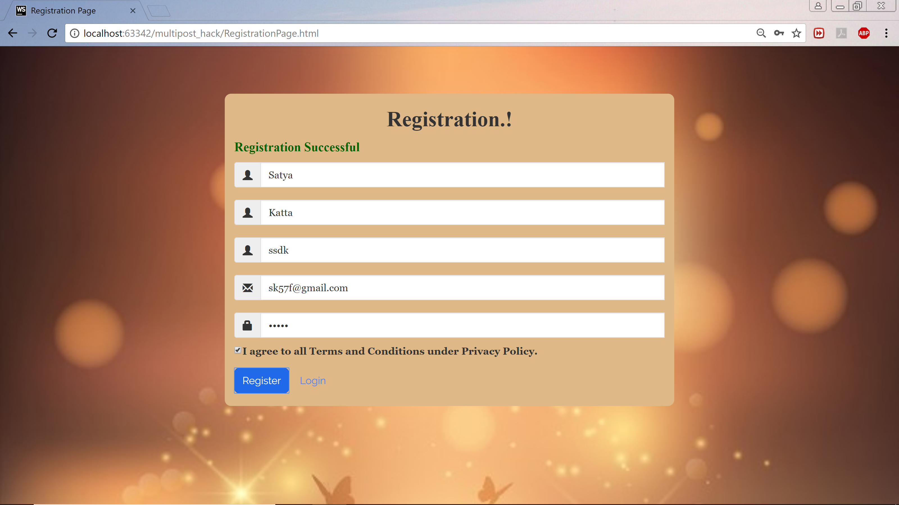
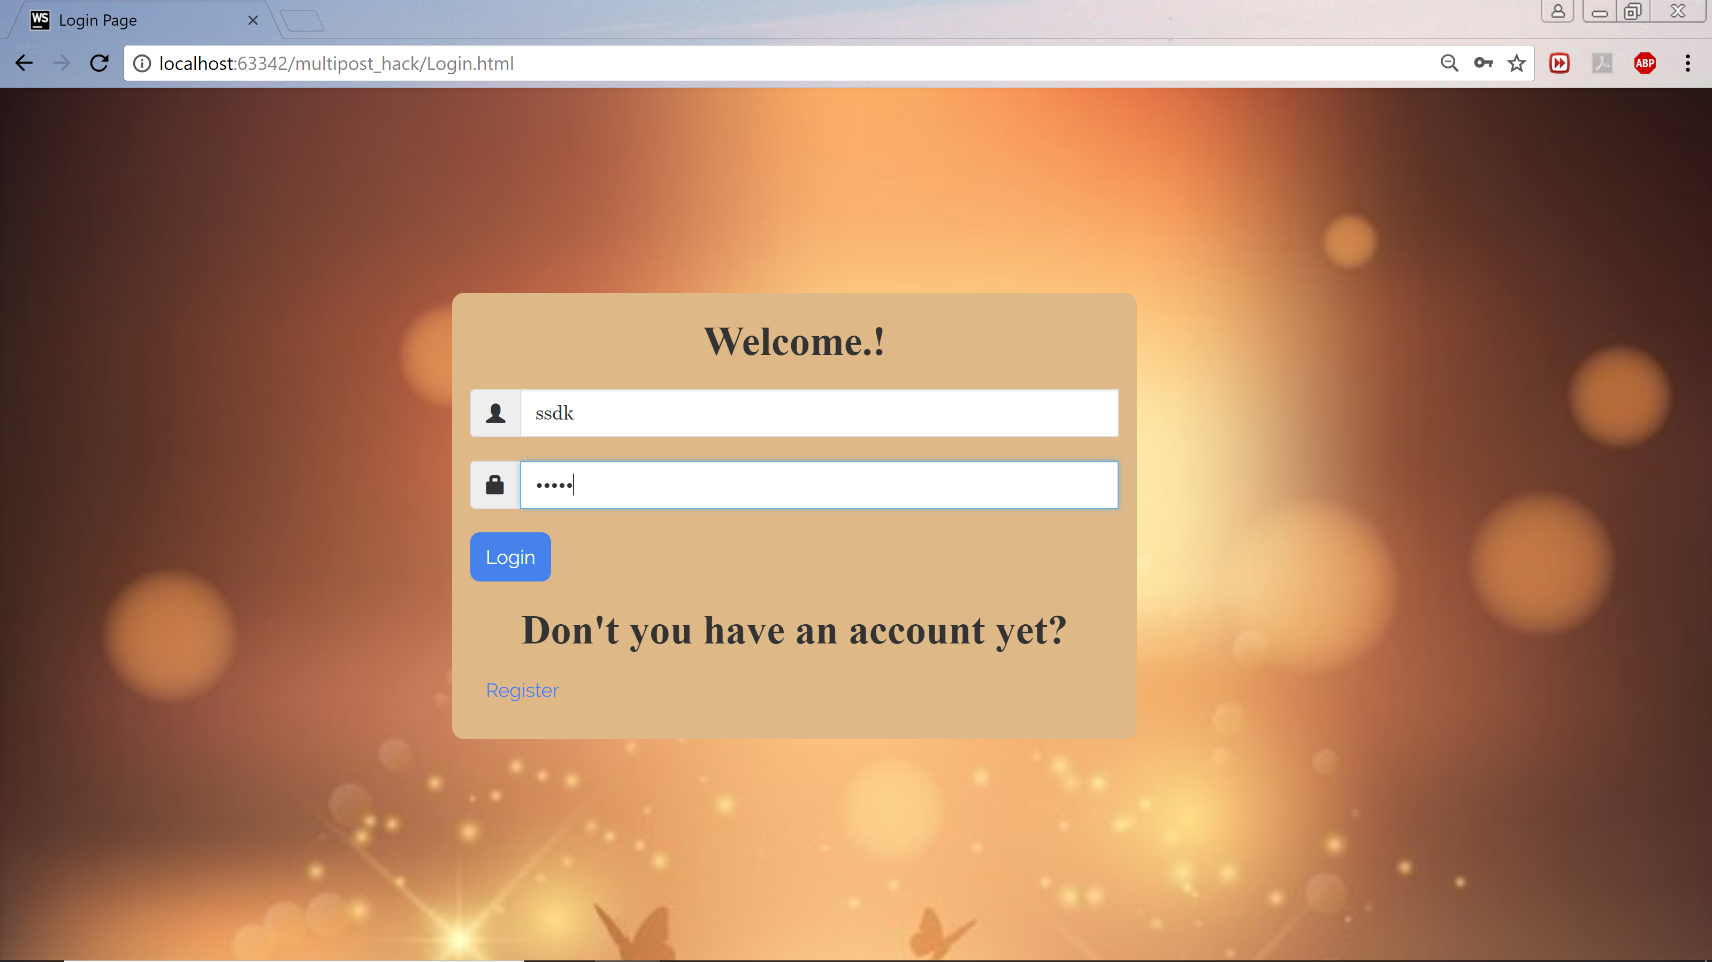
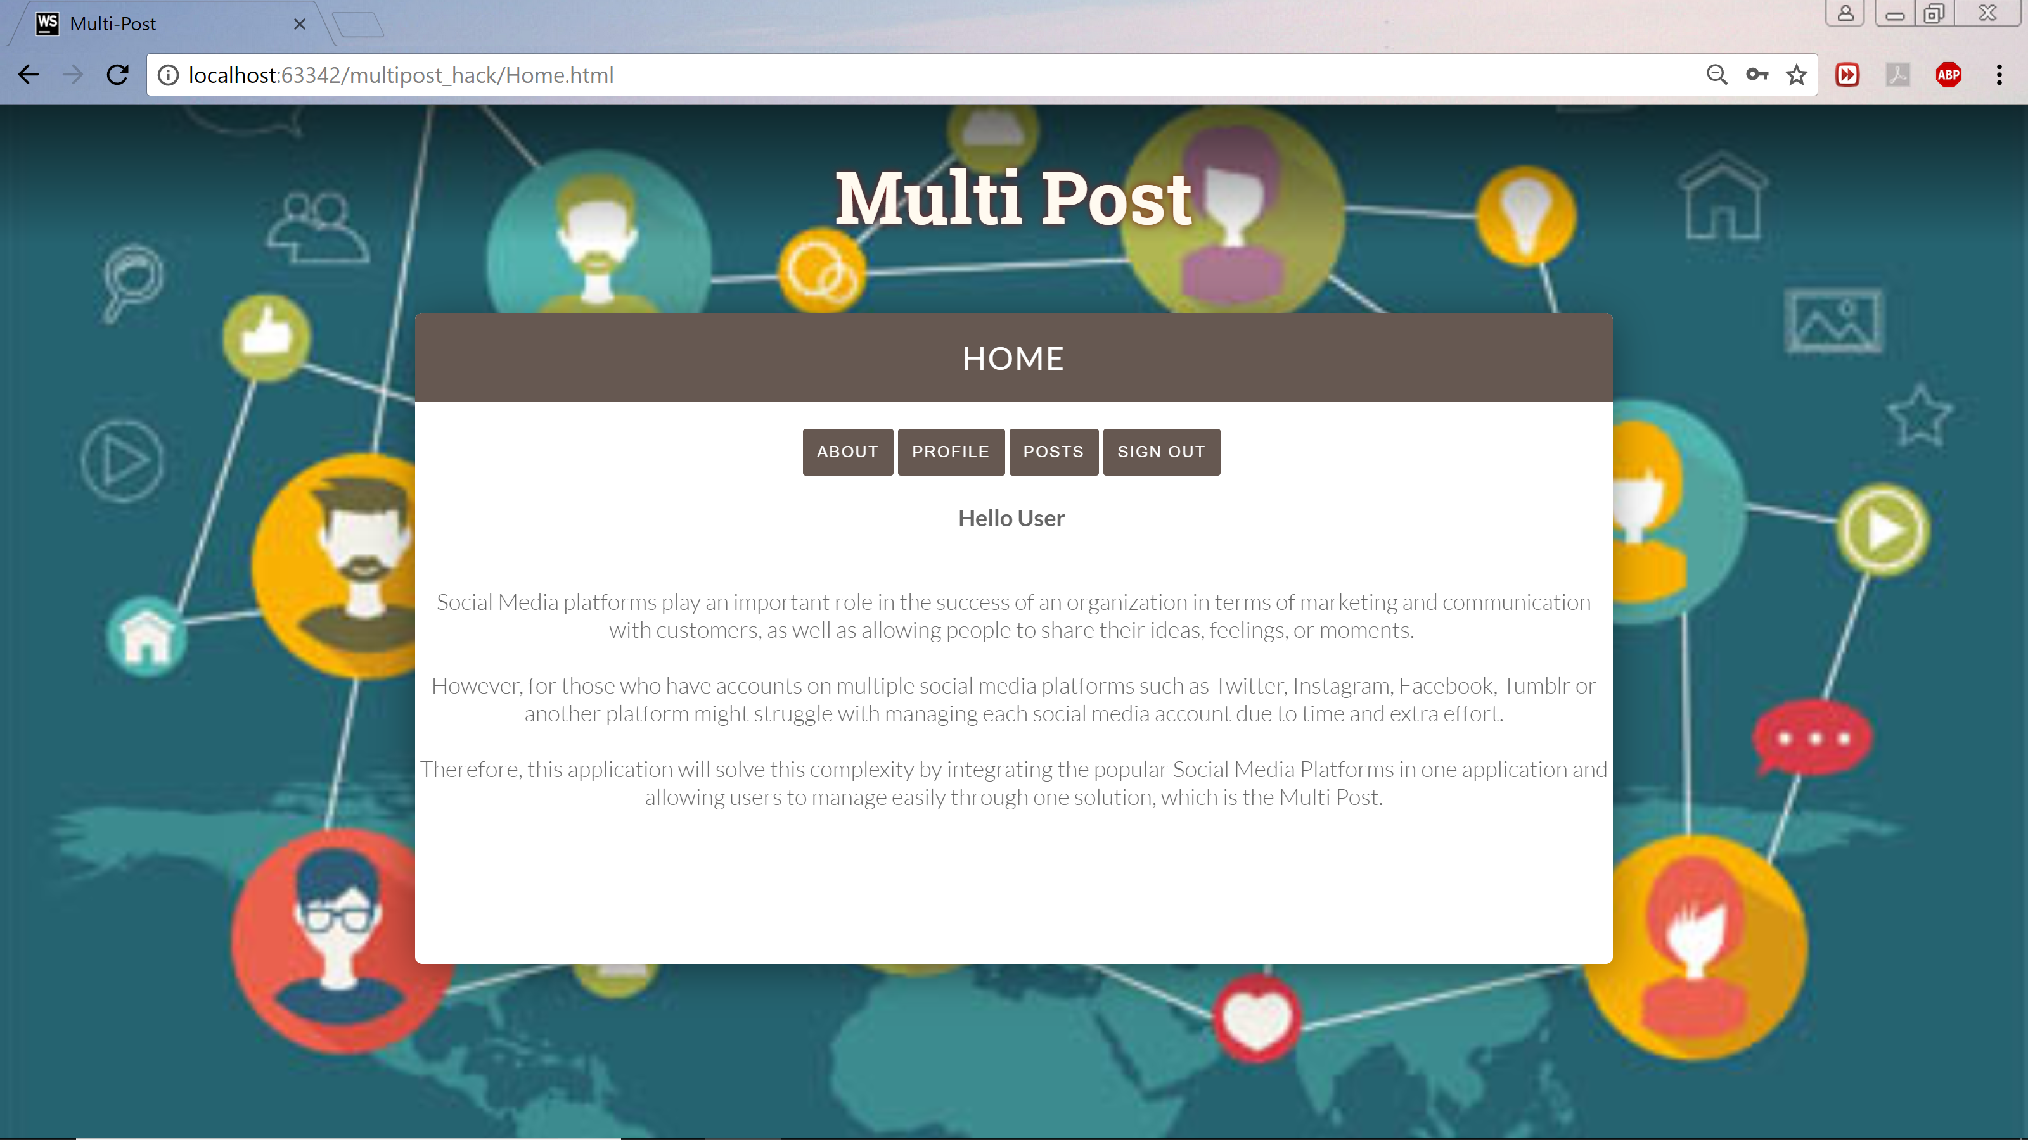
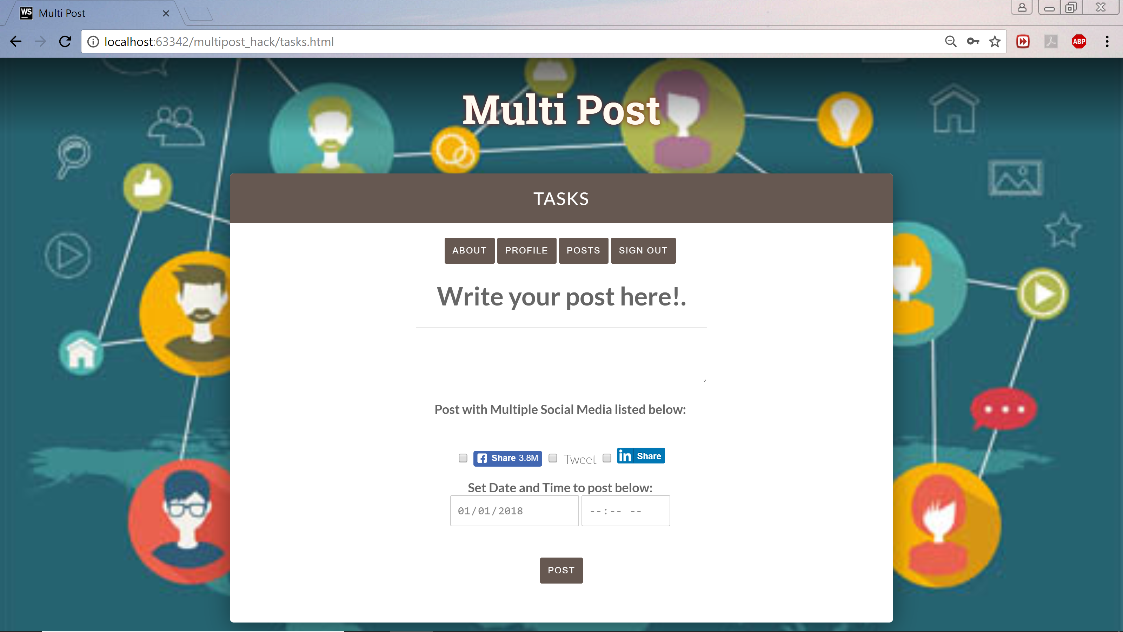

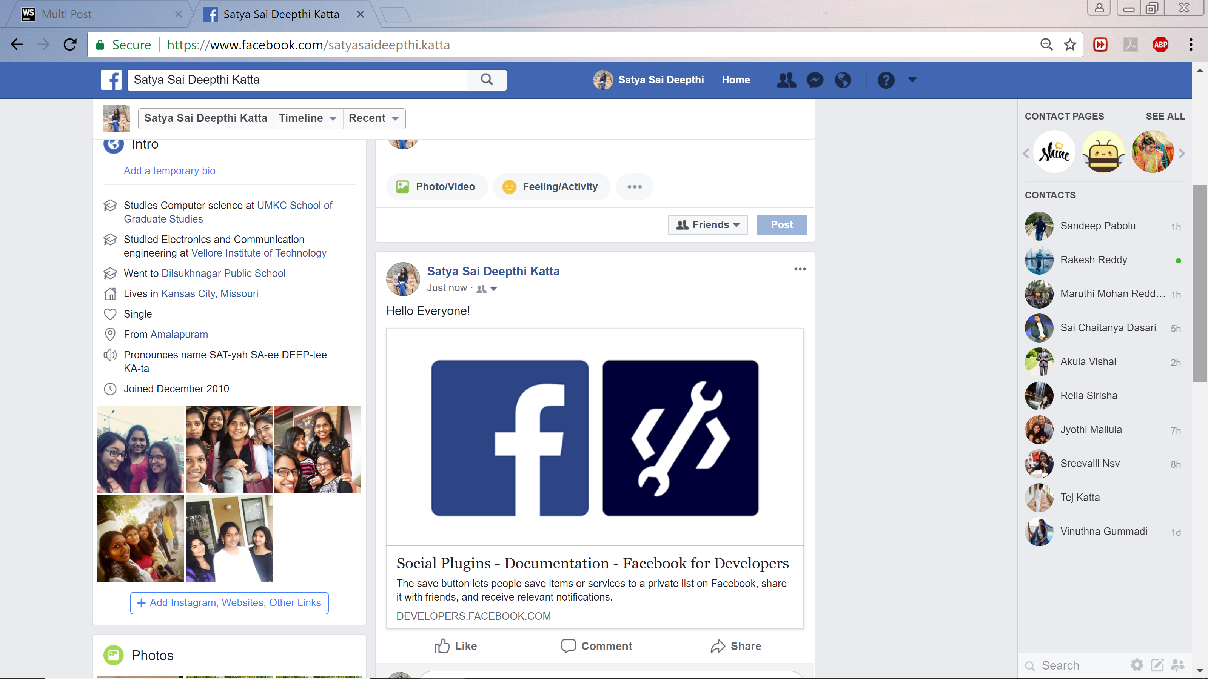
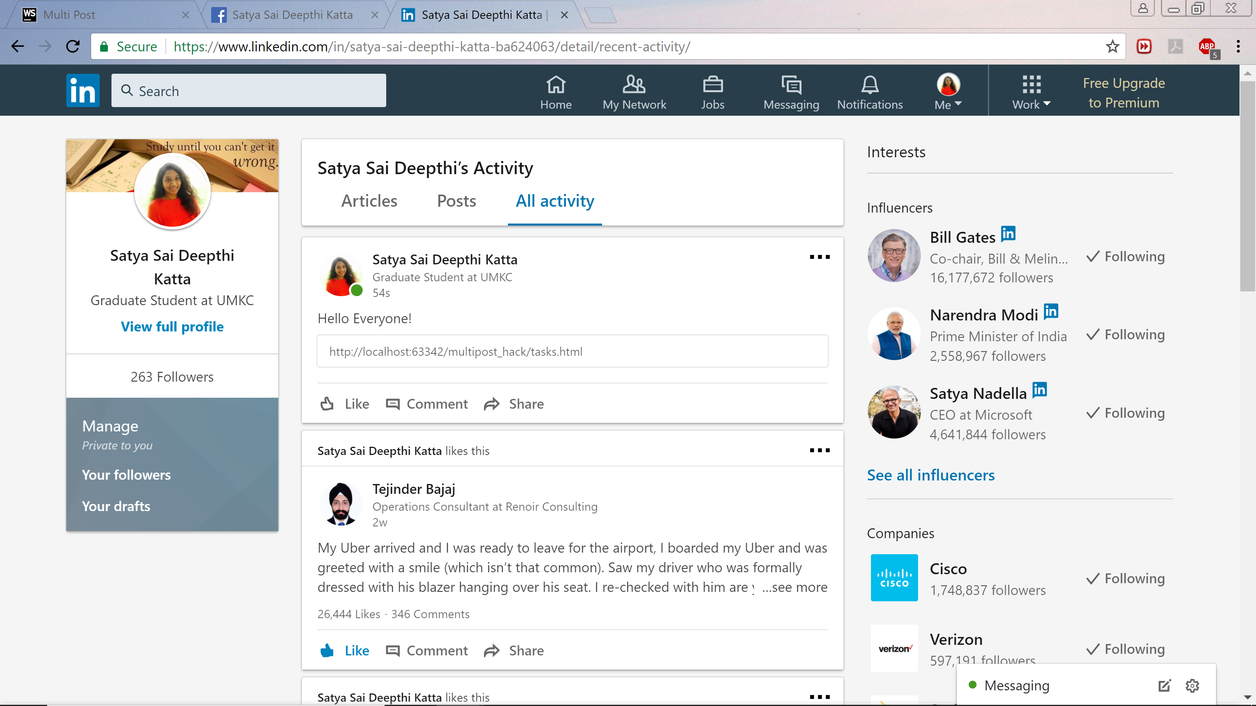
1
2
3
4
5
6

Slide 5
Thank You! ☺

